Slide 1
Week 8 Discussion Section
20th May 2024
Slides can be found on - https://github.com/n2mittal/COGS138-Sp24

Slide 2
Large-scale Automated Synthesis of Human Functional Neuroimaging Data
Notes:
This paper discusses a framework called NeuroSynth, which is an automated approach to synthesize and analyze large amounts of human functional neuroimaging data. It uses text mining, meta-analysis, and machine learning techniques to generate mappings between neural and cognitive states.

Slide 3
Introduction
Rapid growth of neuroimaging literature has led to advances but also challenges in aggregating and synthesizing findings.
Current approaches rely heavily on manual efforts, limiting their scope and efficiency.
NeuroSynth is a fully automated framework for large-scale synthesis of neuroimaging data.
Notes:
The neuroimaging field has seen a rapid increase in the number of studies, leading to substantial advances in our understanding of the human brain and cognition. However, this growth has made it increasingly difficult to aggregate and synthesize findings across multiple studies. Current approaches to meta-analysis and data synthesis heavily rely on manual efforts, which limits their scope and efficiency. The NeuroSynth framework aims to address this by providing a fully automated approach to large-scale synthesis of neuroimaging data.

Slide 4
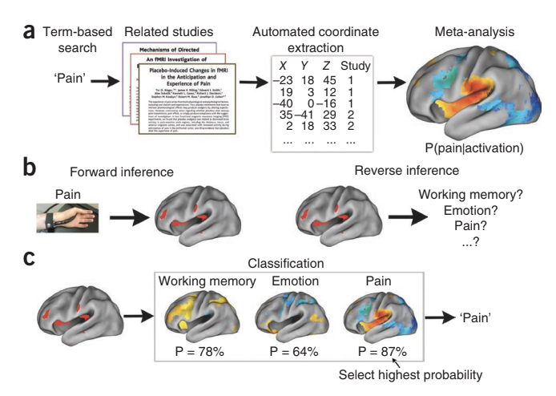
NeuroSynth Framework
Text mining to identify relevant studies
Automatic extraction of activation coordinates from tables
Automated meta-analysis of cognitive concepts
Machine learning for decoding cognitive states
Notes:
The NeuroSynth framework consists of several steps:
It uses text mining techniques to identify relevant neuroimaging studies that frequently use specific terms of interest, such as "pain," "emotion," or "working memory."
It automatically extracts activation coordinates from tables reported in these studies.
It conducts automated meta-analyses for hundreds of psychological concepts, generating whole-brain maps that quantify the relationships between brain activity and cognition.
It uses machine learning techniques, specifically naive Bayes classification, to estimate the likelihood that new activation maps are associated with specific psychological terms, enabling decoding of cognitive states from brain activity patterns.
Figure 1 | Schematic overview of NeuroSynth framework and applications.
(a) Outline of the NeuroSynth approach. The full text of a large corpus of articles is retrieved and terms of scientific interest are stored in a database. Articles are retrieved from the database on the basis of a user-entered search string (for example, ‘pain’) and peak coordinates from the associated
articles are extracted from tables. A meta-analysis of the peak coordinates is automatically performed, producing a whole-brain map of the posterior probability of the term given activation at each voxel (P(pain|activation)).
(b) Outlines of forward and reverse inference in brain imaging. Given a known psychological manipulation, one can quantify the corresponding changes in brain activity and generate a forward inference, but given an observed pattern of activity, drawing a reverse inference about associated cognitive states is more difficult because multiple cognitive states could have similar neural signatures.
(c) Given meta-analytic posterior probability maps for multiple terms (for example, working memory, emotion and pain), one can classify a new activation map by identifying the class with the highest probability, P, given the new data (in this example, pain).

Slide 5
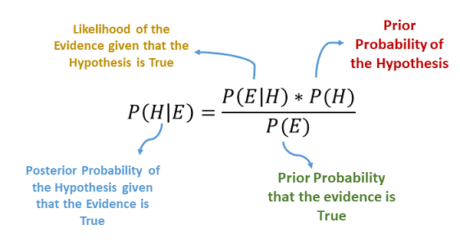
Naive Bayes Classifier
A machine learning technique for classification
Calculates the probability of each class given the input data
Assigns the class with the highest probability
Assumptions: feature independence, features follow a specific distribution
Notes:
The NeuroSynth framework uses a naive Bayes classifier, which is a machine learning technique for classification tasks. It calculates the probability of each class (e.g., "working memory," "emotion," "pain") given the input data (activation maps). The class with the highest probability is then assigned to the input data. The naive Bayes classifier makes the assumptions that features are independent of each other and that they follow a specific probability distribution, such as the Gaussian distribution.

Slide 6
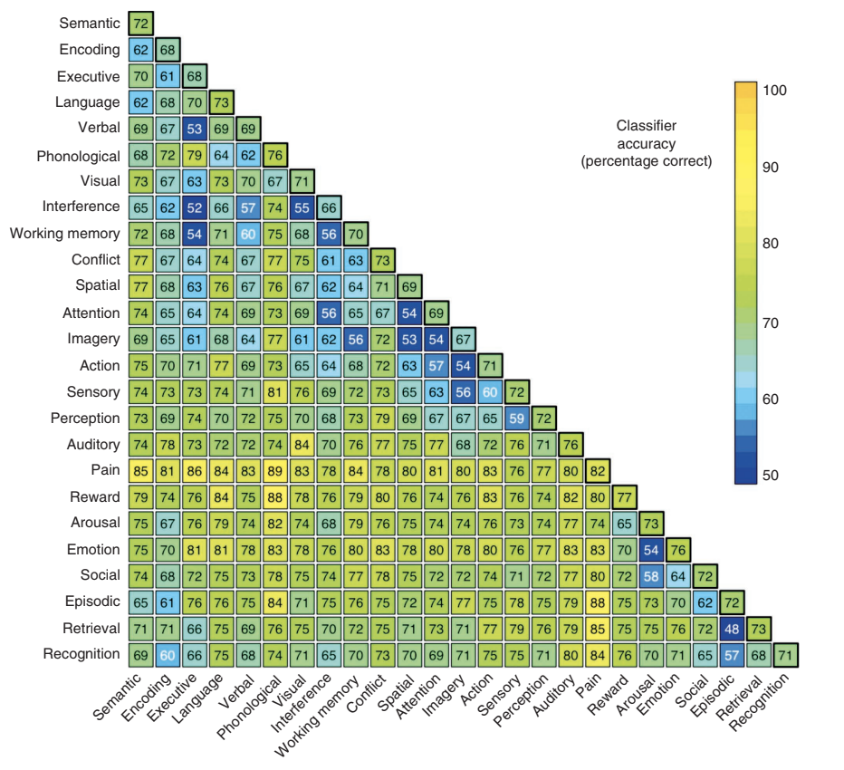
Key Findings
Automated meta-analyses comparable to manual approaches
Quantitative reverse inference to assess specificity
Open-ended classification of cognitive states
Insights into neural representation similarities
Notes:
The key findings of the NeuroSynth framework include:
The automated meta-analyses generated results that were comparable in sensitivity and scope to those produced by manual approaches in previous studies.
The framework enabled quantitative reverse inference, allowing researchers to assess the specificity of mappings between neural and cognitive function, addressing a long-standing inferential problem in neuroimaging.
The framework could decode and classify broad cognitive states in individual subjects in a relatively open-ended way, without requiring prior training data or knowledge of the "ground truth."
The classification analyses provided insights into the similarity structure of neural representations for different cognitive processes, revealing which processes had distinct neural signatures and which were difficult to distinguish.
To generalize beyond working memory, emotion and pain, they selected 25 broad psychological terms that occurred at high frequency in the database (Fig. 5). We estimated classification accuracy in tenfold cross-validated two-alternative and multiclass analyses. The classifier performed substantially above chance in both two-alternative classification (mean pairwise accuracy of 72% Fig. 4). The results provided insights into the similarity structure of neural representation for different processes. For instance, pain was highly discriminable from other psychological concepts (all pairwise accuracies > 74%), which suggests that pain perception might be a distinctive state that is grouped neither with other sensory modalities nor with other affective concepts such as arousal and emotion. Conversely, conceptually related terms such as ‘executive’ and ‘working memory’ could not be distinguished at a rate different from chance, reflecting their closely overlapping usage in the literature.

Slide 7
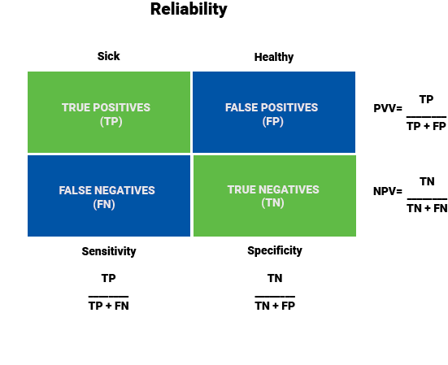
Sensitivity and Specificity
Sensitivity: Proportion of true positives correctly identified
Specificity: Proportion of true negatives correctly identified
High sensitivity and specificity indicate accurate classification
Notes:
The paper discusses the concepts of sensitivity and specificity, which are commonly used in classification tasks and diagnostic tests.
Sensitivity refers to the proportion of true positives that are correctly identified by the classifier or test. For example, if a classifier aims to identify subjects experiencing pain, sensitivity would be the proportion of subjects actually experiencing pain that are correctly classified as such.
Specificity refers to the proportion of true negatives that are correctly identified. In the pain example, specificity would be the proportion of subjects not experiencing pain that are correctly classified as not experiencing pain.
A classifier or diagnostic test with high sensitivity and high specificity is considered accurate, as it correctly identifies both positive and negative cases.

Slide 8
Limitations and Future Work
Reliance on lexical coding approach (using psychological terms)
Limited ability to extract fine-grained cognitive states
Future work:
Use controlled vocabularies or ontologies
Develop multi-term analyses
Extract topic-based representations
Notes:
The NeuroSynth framework has some limitations:
It relies on a lexical coding approach, using traditional psychological terms that may not accurately capture the underlying neural substrates or differentiate closely related constructs.
The automated tools are currently limited in their ability to extract information about fine-grained cognitive states, such as different types of emotions or pain. Future work aims to address these limitations by:
Using controlled vocabularies or ontologies for query expansion, which could better capture the underlying concepts.
Developing extensions for conducting multi-term analyses, allowing for more nuanced representations.
Extracting topic-based representations from article text, rather than relying solely on specific terms.

Slide 9
Conclusion
NeuroSynth is a powerful and generative framework for large-scale synthesis of human neuroimaging data.
Enables quantitative reverse inference and open-ended decoding of cognitive states.
Potential applications in defining regions of interest, Bayesian priors, and contextualizing new findings.
Publicly available tools and data: http://neurosynth.org/
Notes:
In conclusion, the NeuroSynth framework represents a powerful and generative approach for large-scale synthesis of human neuroimaging data. It enables researchers to conduct quantitative reverse inference, addressing a long-standing inferential problem, and to decode cognitive states in an open-ended manner. The framework has potential applications in defining regions of interest, setting Bayesian priors for hypothesis-driven analyses, and contextualizing new research findings based on published data. The tools and data used in this study have been publicly released through a web interface at http://neurosynth.org/, encouraging further development and application of this synthesis-oriented approach.

